Slide 1
General Military Application for ML/AI
Graham Latsa
IST707
6/5/2019

Slide 2
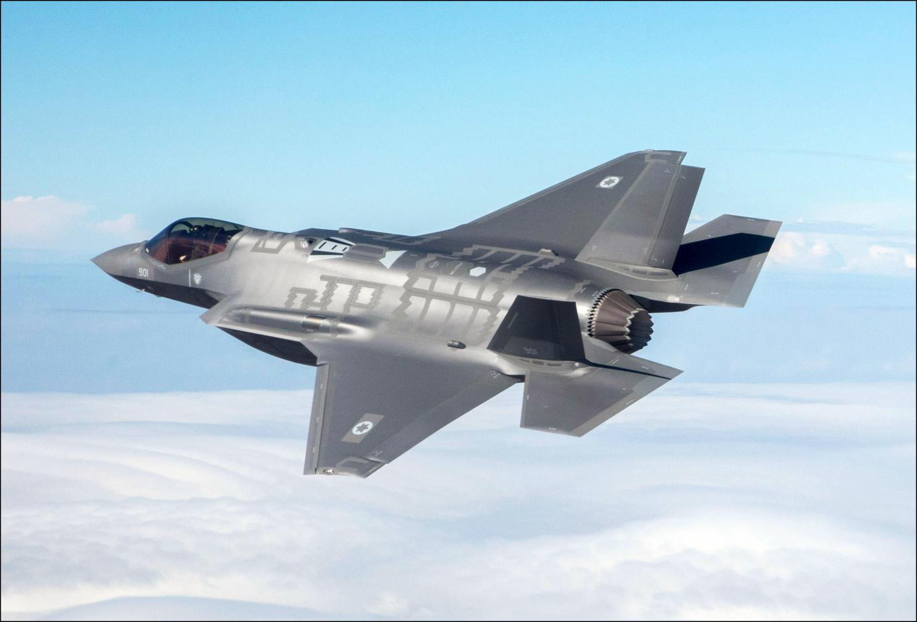
Current Situation
“Military customers have similar requirements when it comes to predictive analytics as they do for other applications, the difference being the stakes are higher in the military with the focus on the warfighter”
Jim Fitzgerald, Ex-Navy Pilot & Top Gun Graduate
8 Focus Areas
Warfare Platforms
CyberSecurity
Logistics & Transportation
Target Recognition
Battlefield Healthcare
Training
Threat Monitoring & Awareness
Data Information Processing

Slide 3
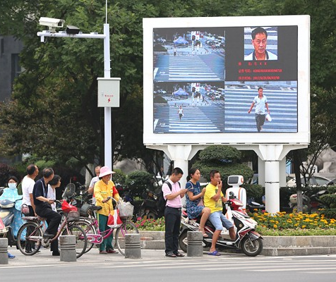
Competition
The DoD overall spent USD 7.4 billion on artificial intelligence, Big Data, and cloud in 2017, while China is betting on AI to enhance its defense capabilities and is expected to become the world leader in this field by 2030
https://www.independent.co.uk/news/world/asia/china-police-facial-recognition-technology-ai-jaywalkers-fines-text-wechat-weibo-cctv-a8279531.html

Slide 4
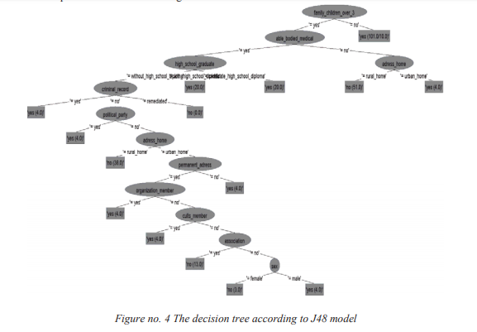
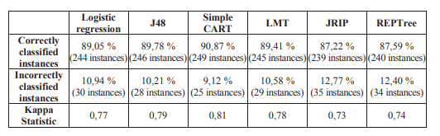
Real Life Examples

Slide 5
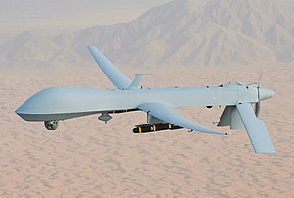
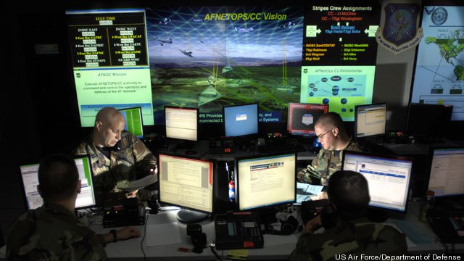
Real Life Examples
Automation
Routing
Image Recognition
Notifications
Data Preprocessing
Error Checking

Slide 6
Sources
DATA MINING FOR PREDICTING THE MILITARY CAREER CHOICE.Land Forces Academy Review, 20(3), 297-306. Retrieved from https://search.proquest.com/docview/1768623456?accountid=14214
https://www.independent.co.uk/news/world/asia/china-police-facial-recognition-technology-ai-jaywalkers-fines-text-wechat-weibo-cctv-a8279531.html
https://blog.marketresearch.com/8-key-military-applications-for-artificial-intelligence-in-2018
http://mil-embedded.com/articles/military-learning-speeds-decision-making-efficiency-warfighters/

